Slide 1
Group 7
Logan Fortune
Andy Winata
Joe Bellaish
Travis Lawrence
Vincent Poon
Notes:
This is Group 7, im (insert your name)

Slide 2
Overview:
Team Introduction
Project overview
Experiment results
Conclusion
Challenges
Takeaways
Notes:
We will breifly discuss about what the project is about, how we implemented the update
Experiemnt results, what we learn from the results. And challenges we faced.

Slide 3

Operation Deutsche Weinstraße
Notes:
Operation i don't know how to pronounce -.-

Slide 4




Project Description
A young artificial intelligence professor has been commissioned to deliver his most illustrious wines to all the prestigious restaurants of Houston.
For safety reasons, he can only carry one bottle at a time
He must find the most lucrative path from wine cellar to restaurant.
Help him discover this path using reinforcement learning
Notes:
Project in disguise, just read through the slides

Slide 5
Project Goals
Utilize the reinforcement learning concepts like utilities and policies.
Agent will receive rewards / penalty depending on how efficiently he can deliver the wines.
After some time, the agent should be able to know the most promising paths from wines to restaurants
That path should lead to rewards.
Notes:
Read the slides

Slide 6
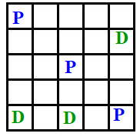

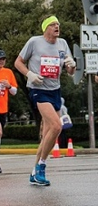



World and policy
A 5 x 5 world with 3 pickups/drop off location each
3 policies used to select the next operator:
PGREEDY: always the most promising operator
PEXPOLIT: most of the time most promising operator, sometime random
PRANDOM: always randomly choosing an operator
Notes:
The world is a 5 x 5 grid world that have 3 pickup/ drop off scatter on the world, and agent is going to work it’s way to learn the paths
PGREEDY: we grab the best we can see, nothing else matter
PEXPOLIT: most of the time we are greedy, else, meh, i decide to do whatever i want
PRANDOM: Tho the that way look good, i am going to roll a dice and hope for the best

Slide 7

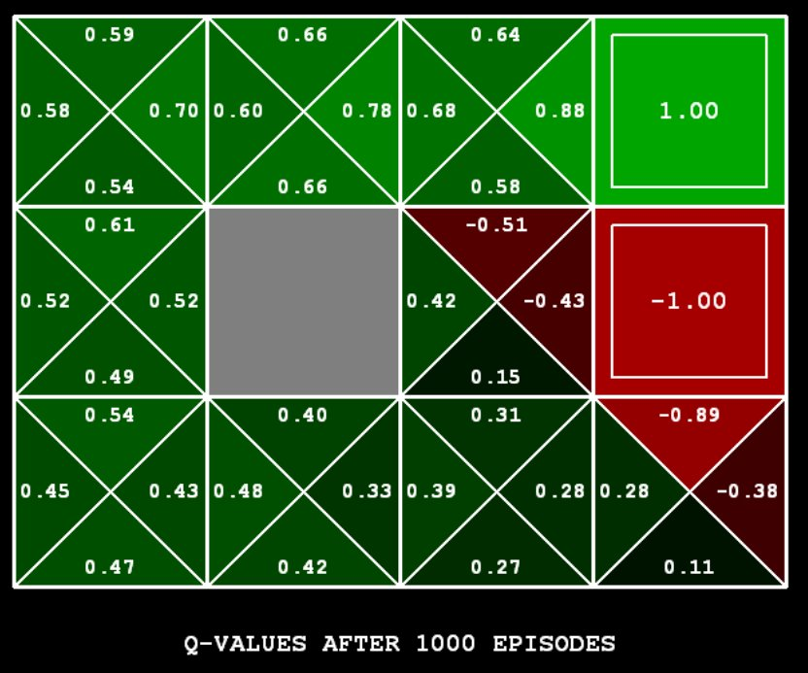
Algorithms
Learning methods: ( a = learning rate, γ = discount factor)
Q - learning: Q(a,s) = (1-a)*Q(a,s) + a*[R(s’,a,s)+ γ*max_{a’}Q(a’,s’)]
In short, q learning looks at the best option we have in the next state
SARSA: Q(a,s) = (1-a)*Q(a,s) + a*[R(s’,a,s)+ Q(a’,s’)]
In short, SARSA looks at what happens if we apply an applied operator in next state
Observation
Agent
Environment
Action
Notes:
Read off the slide

Slide 8
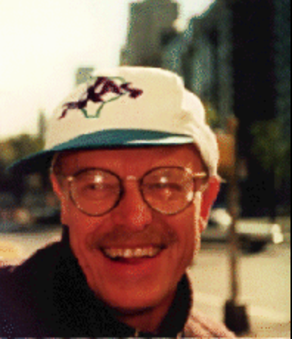
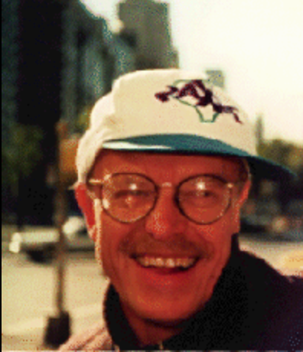
Updating the Q-Table
To calculate the new value of the Q table, we need to know the move our agent will take next.
Instead of updating the node immediately, we wait until the agent leaves and ask where did the agent go.
“I’m always two steps ahead!”
“Where will i go?”
“I go to the Rainbow Lodge at (3,2) and get +13!”
SARSA only
Notes:
Insert drama, (used for time control manner)

Slide 9
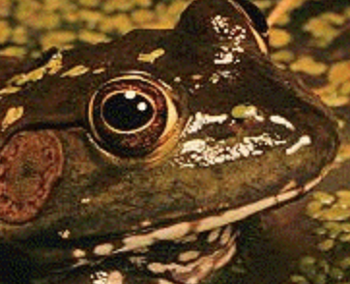

Experiments
?
?
?
!
!
1: Apply Q-learning algorithm for 4000 steps with policy PRANDOM, then run PGREEDY policy for another 4000 steps
2: Apply Q-learning algorithm for 200 steps with policy PRANDOM then 7800 steps with PEXPLOIT
3: Apply SARSA algorithm for 200 steps with policy PRANDOM then 7800 steps with PEXPLOIT
4: Replace gamma(discount rate of experiment 3 from 0.5 to 1)
5: Same as Experiment 2, but now the pick up/ drop off location flips on second completion
Notes:
Read it if we have extra time

Slide 10
Experiment Results
PRANDOM : the attractive path is clear.
pick up and dropoff highlighted green
the further away from pickup/dropoff locations the more red it becomes.

Slide 11
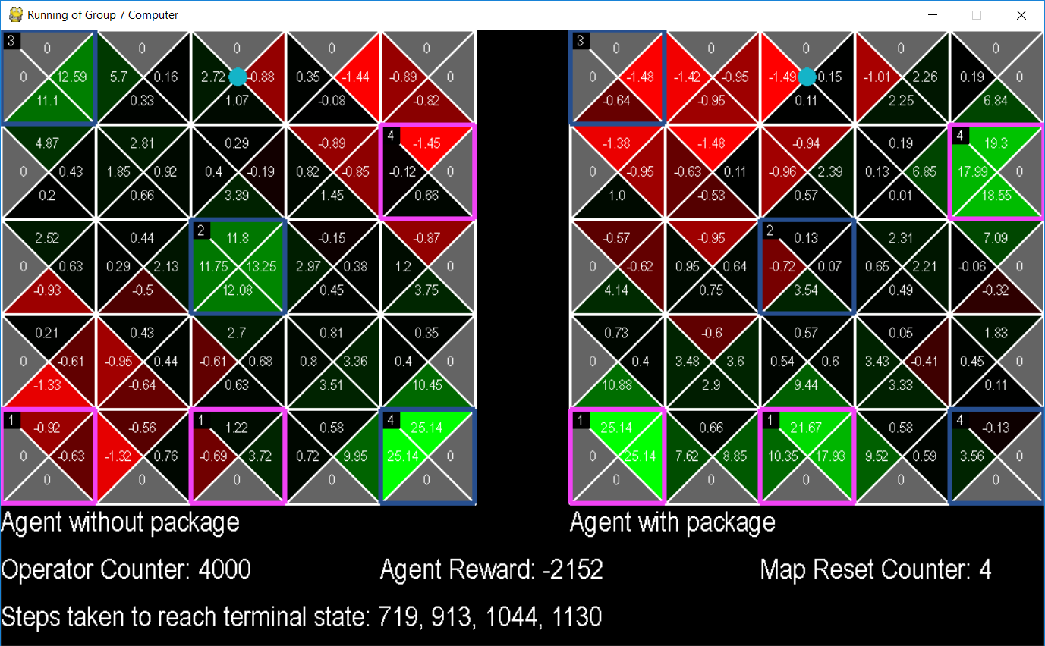
4000 PRANDOM from Experiment 1
Notes:
Go through how to read the map
Note the top right, bottom left is red on left map
Top left is red on right map

Slide 12
Experiment Results (1)
Now we stop wandering around and hope for the best
The attractive is less identifiable, as it spreads the red out once the best action is red
It improves the performance of the Agent by taking the most attractive path

Slide 13
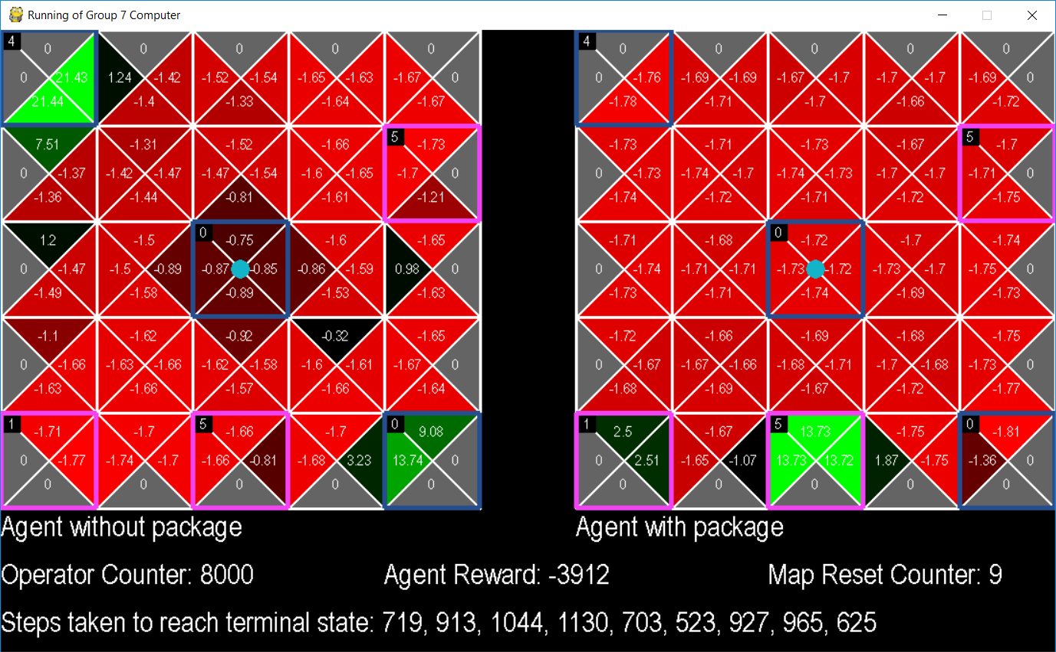
4000 PGREEDY for Experiment 1
Notes:
It completed 5 times after changing policy

Slide 14
Experiment Result(2)
(200 PRANDOM, 7800 PEXPLOIT, Q-Learning)
When a terminal state is reached:
Only 1 pick up / drop off is green, because others no longer provide reward

Slide 15
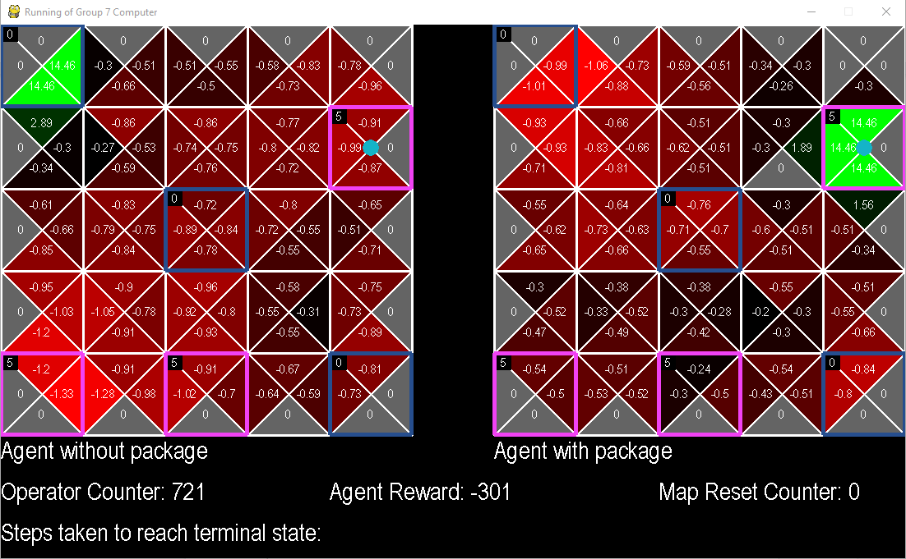
First termination

Slide 16
Experiment Result(2)
At 8000 steps, terminal state has been reached 9 times.
Similar trends to experiment 1.
The later in the experiment, the more steps you need.

Slide 17
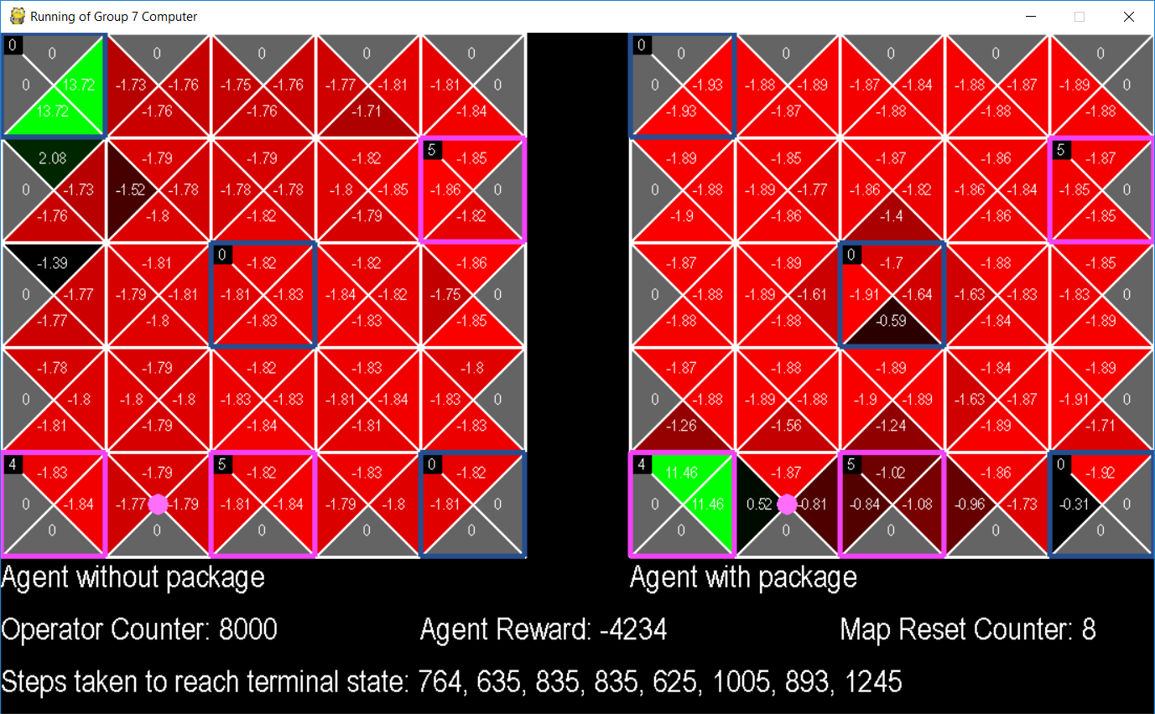
At step 8000
Notes:
Notice agent just need 1 more step to complete

Slide 18
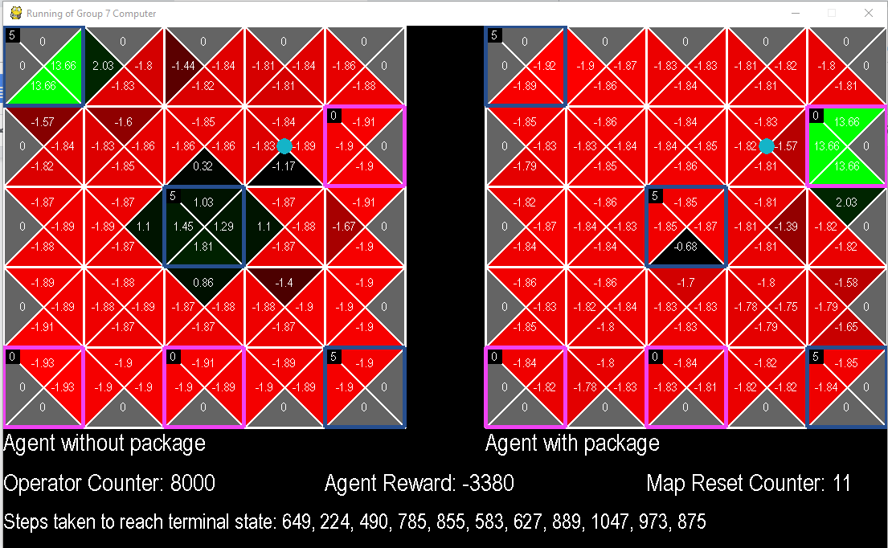
Experiment (3) SARSA instead of Q-Learning
The table look similar to Experiment 2
It completed 11 times, instead of 8
SARSA is better than Q-Learning in a changing world

Slide 19
At step 8000

Slide 20
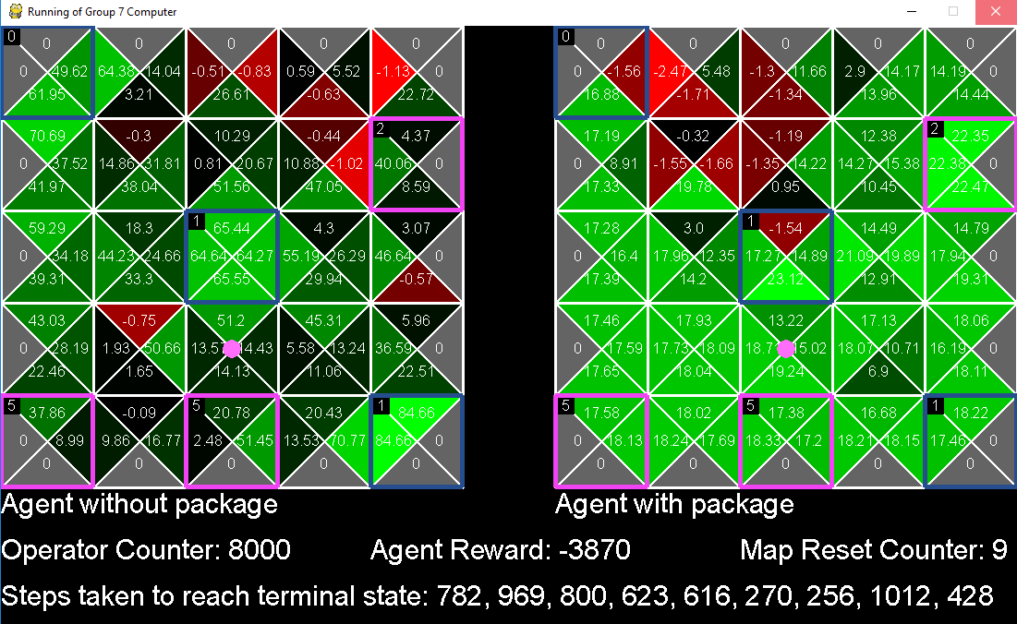
Experiment (4) Gamma = 1 vs 0.5
The agent now sees further into the future
Gamma changed too far ( the whole map turned green )

Slide 21
At step 8000

Slide 22
Experiment (5), agent return the blocks
The pick-up and drop off will be flipped on second termination
It affected the agent, but it figures it out quickly
Third termination takes longer, then back to normal
We reached terminal state 8 times total, which is less than previous experiments

Slide 23
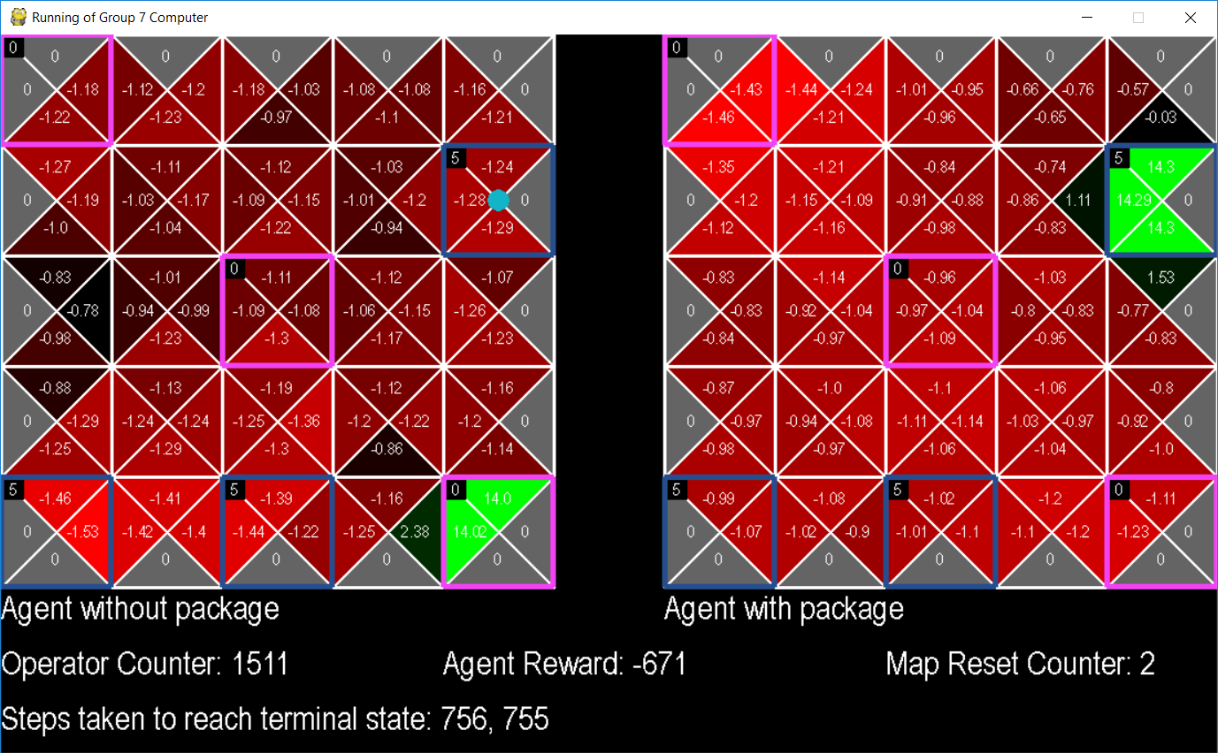
Experiment 5, termination 2

Slide 24
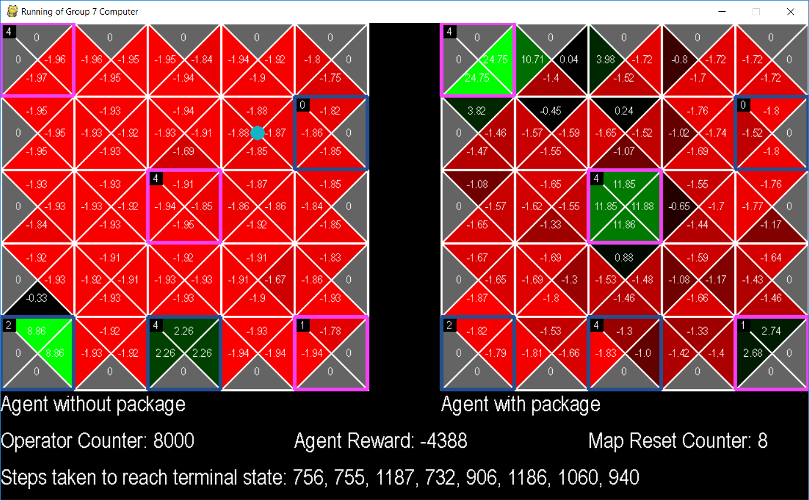
Experiment 5, state slipped after second termination

Slide 25

Experiment Conclusions
Hey, now we know how to deliver bottles of wine efficiently.

Slide 26
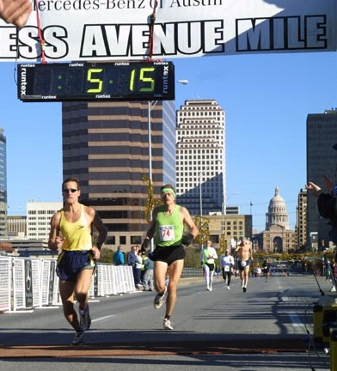
Conclusions
It’s all about the trade off between exploration and exploitation
There is a sweet spot of adjusting the alpha/gamma value
For gamma there is no point to look ahead 10 years if the agent will not live through tomorrow
It is proven that reinforcement learning is resilient to changes in the world
"The gun goes off and everything changes...the world changes...and nothing else really matters."
Patti Sue Plummer, Olympian.

Slide 27
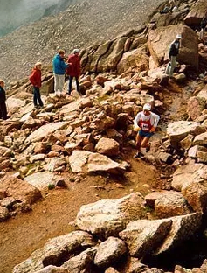
Challenges
Technical challenges:
No one on the team has had python experience or used a python programming environment before.
Creating a good visualization of the project
Non-technical challenges:
Time management for meetings
Committing to deadlines

Slide 28

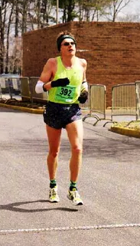
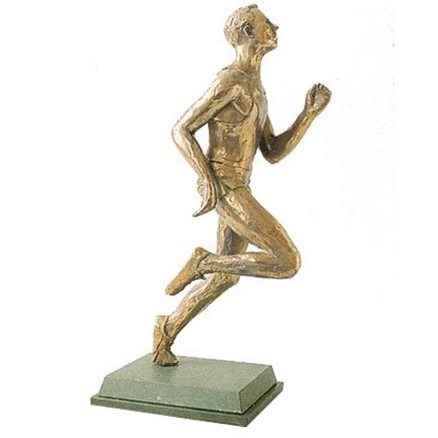
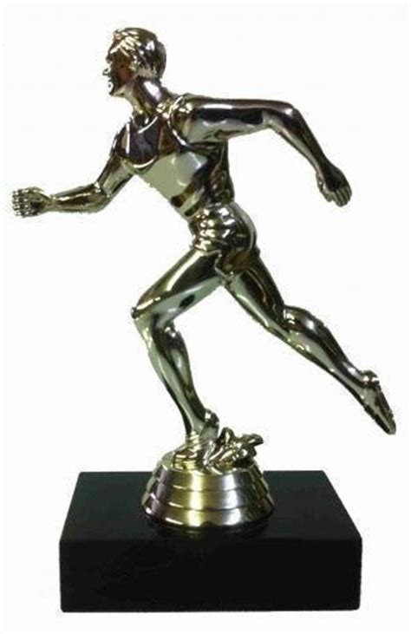
Takeaways
Take more initiative to push the project progress
Working in groups requires sacrifice and understanding
More does not mean the better when it comes to turning parameters
Artificial Intelligence does not mean waving a magic wand over a computer, it is powered by data and learning through training

